Slide 1

Data Analytics & Visualisation
Assignment 1 – Visualisation of a Dataset
Givaldo

Slide 2
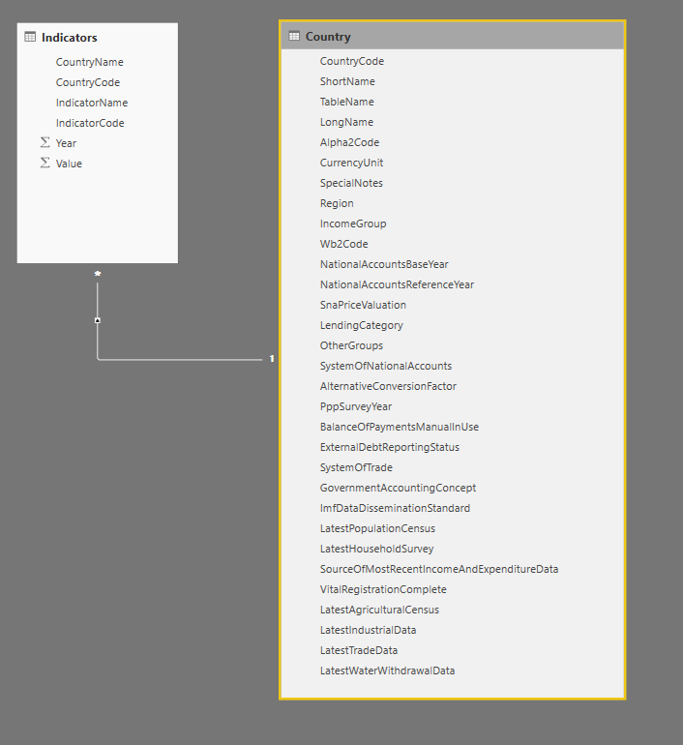
Dataset
More than 1.6 Millions lines

Slide 3
Top 10 GDP from Europe

Slide 4
Life expectancy vs GDP Some European countries

Slide 5
Life expectancy vs GDP Separeted by continents

Slide 6
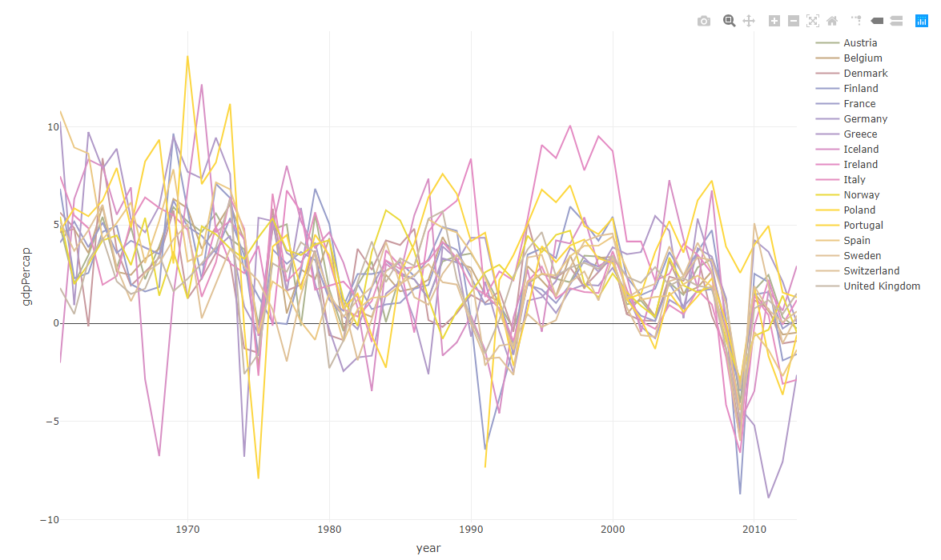
GDP from some Europe countries.

Slide 7
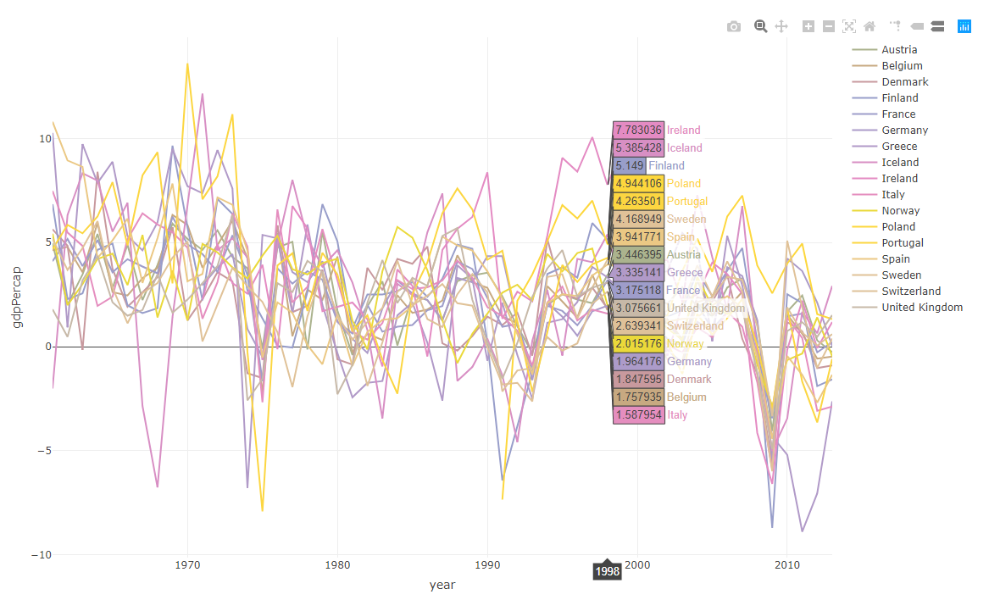
GDP from some Europe countries.
Interactive graph

Slide 8
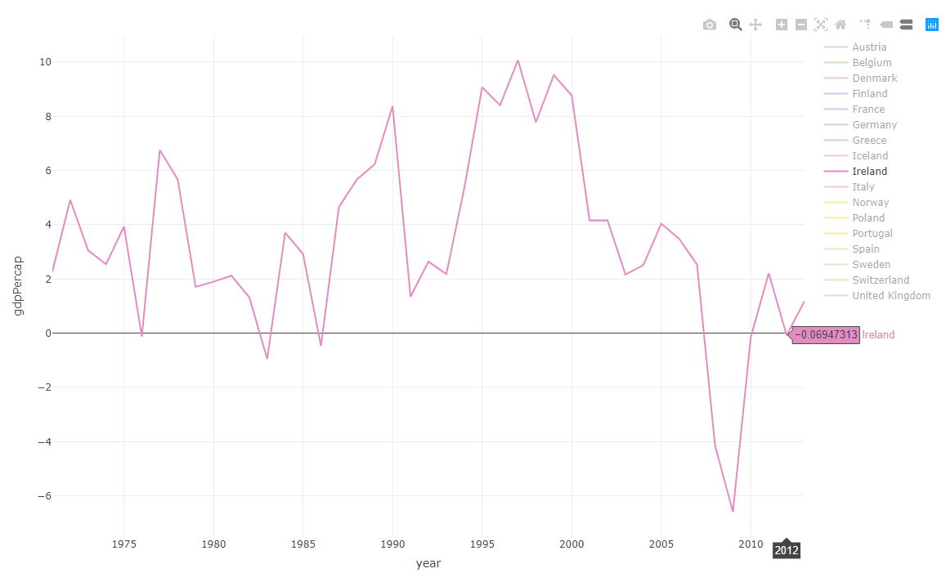
GDP from some Europe countries.
We can select just one or more lines

Slide 9
Animated line graph

Slide 10
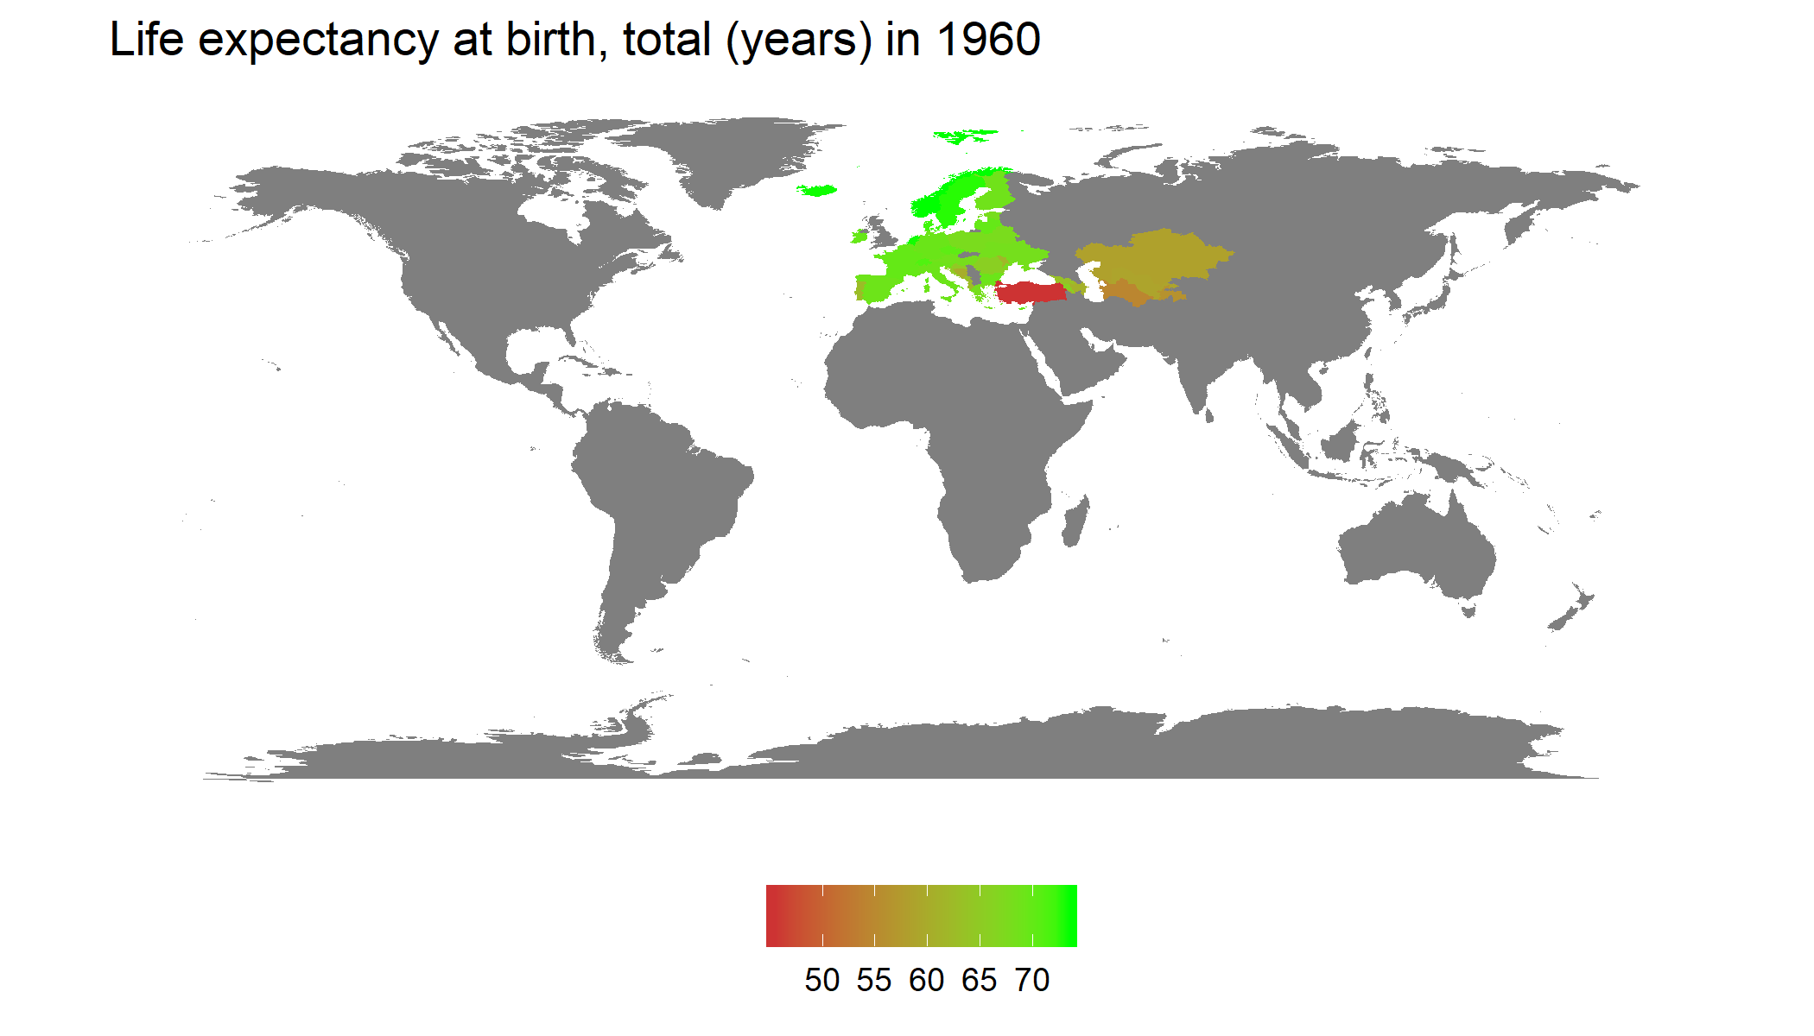
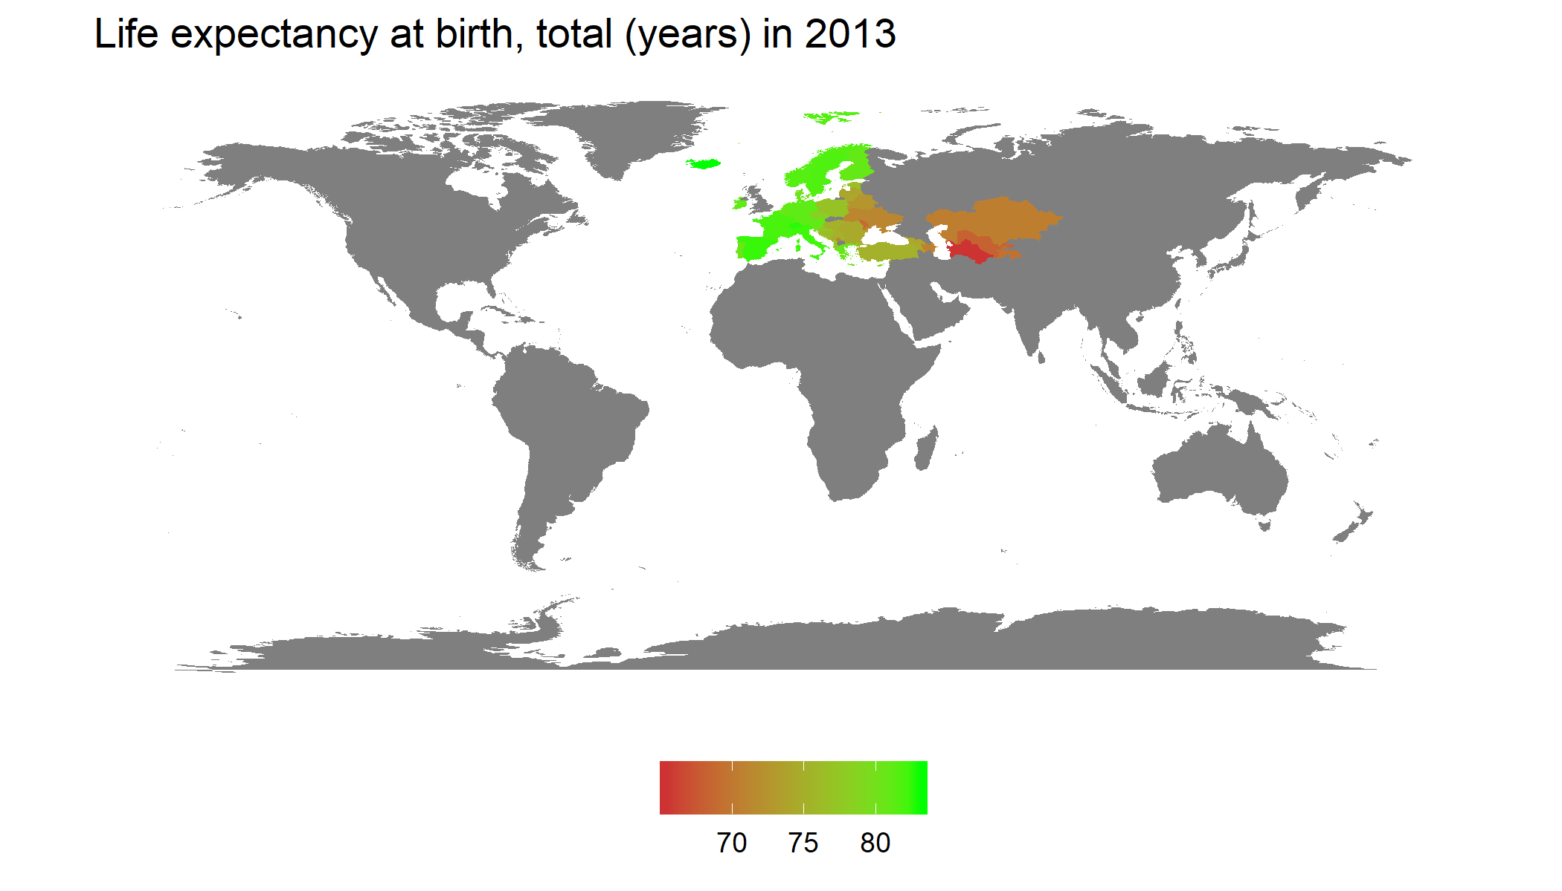
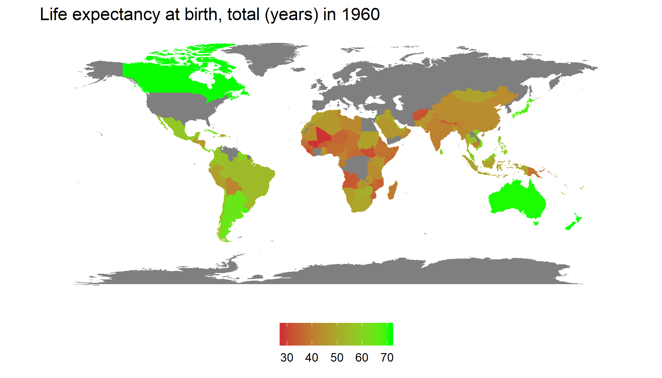
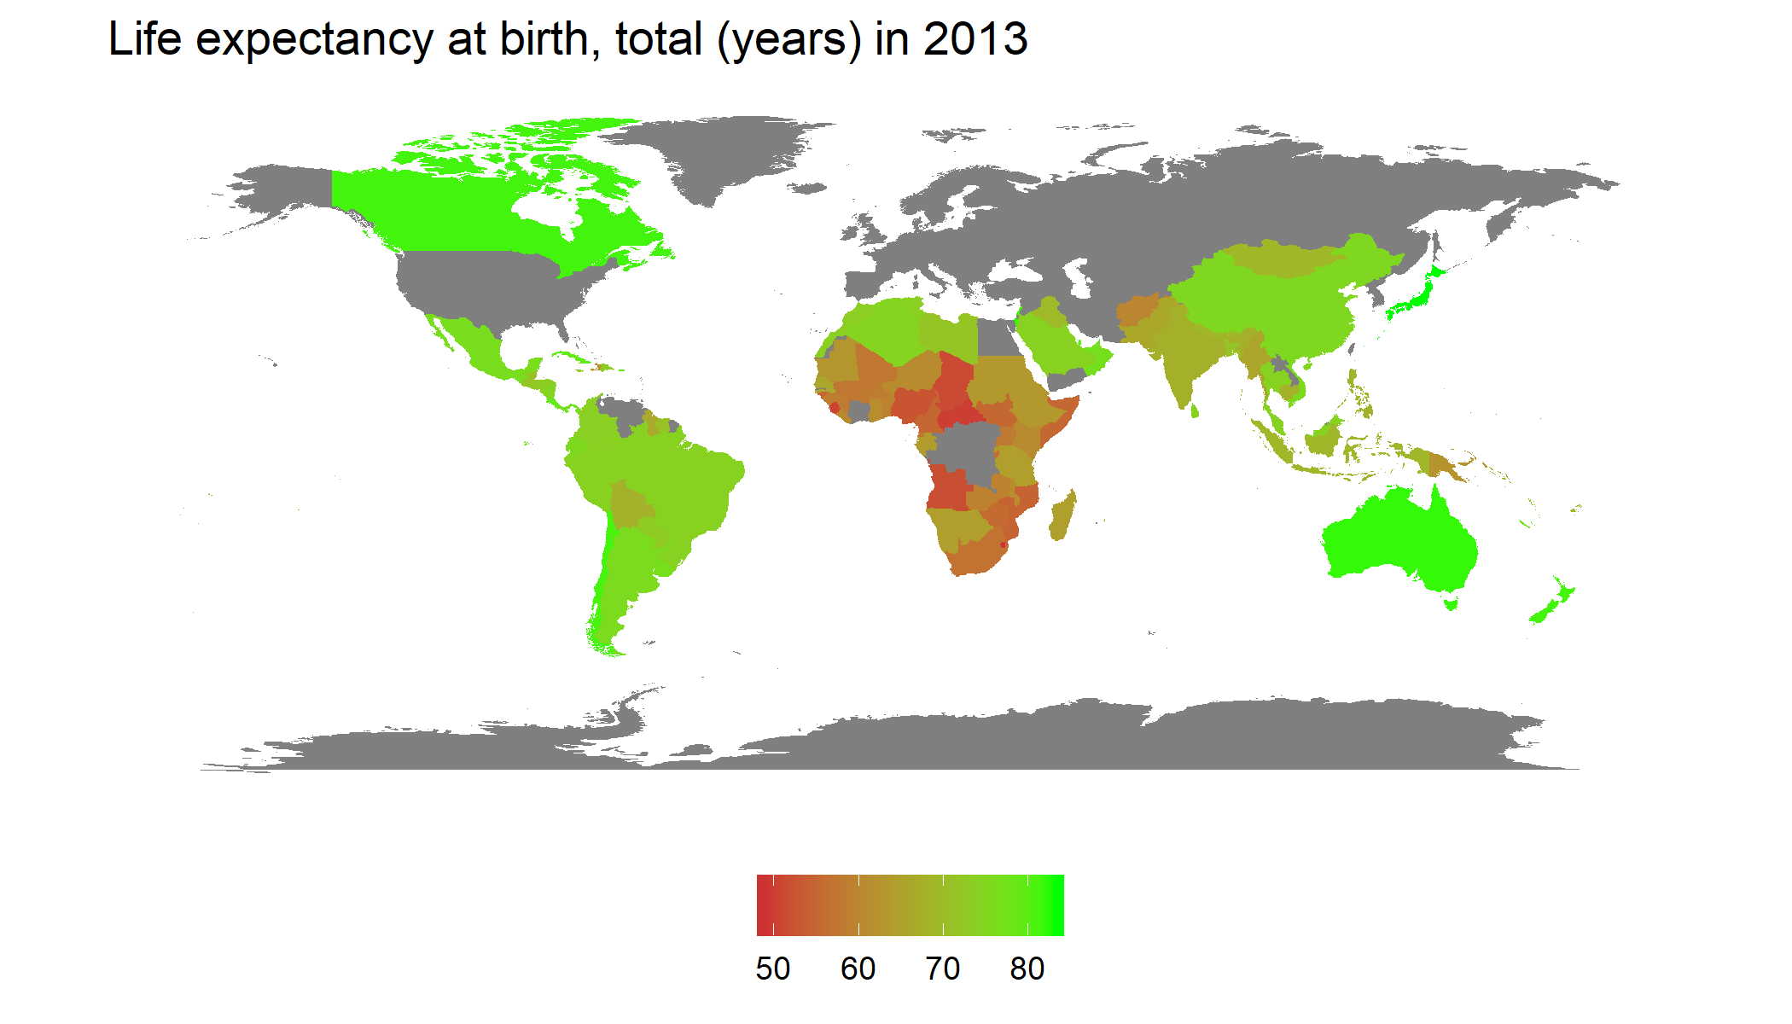

Slide 11
Evolution of corona virus

Slide 12
References
[1]G. Grolemund and H. Wickham, 5 Data transformation | R for Data Science. .
[2]“amrrs/animated_bar_charts_in_R: Code to demo how to build Animated Bar Charts in R.” [Online]. Available: https://github.com/amrrs/animated_bar_charts_in_R. [Accessed: 15-Mar-2020].
[3]“Bar Chart Races With gganimate.” [Online]. Available: https://emilykuehler.github.io/bar-chart-race/. [Accessed: 15-Mar-2020].
[4]“Data Science,” edX. [Online]. Available: https://www.edx.org/micromasters/uc-san-diegox-data-science. [Accessed: 15-Mar-2020].
[5]“Emigration by age and sex - ecodp.common.ckan.site_title.” [Online]. Available: https://data.europa.eu/euodp/en/data/dataset/MfkEgsB8RmSr3syAcyHCw. [Accessed: 15-Mar-2020].
[6]R. L. Muenchow Jakub Nowosad, Jannes, Geocomputation with R. .
[7]M. Roser, E. Ortiz-Ospina, and H. Ritchie, “Life Expectancy,” Our World in Data, May 2013.
[8]P. Rotzetter, protzetter/coronavirus. 2020. https://github.com/protzetter/coronavirus
[9]“World Development Indicators.” [Online]. Available: https://kaggle.com/worldbank/world-development-indicators. [Accessed: 15-Mar-2020].

